Slide 1
Chapter 2 Data Control and Data Organisation

Slide 2

Why do doctors know your medical records?
In 2008, the Hong Kong government developed an electronic platform, “eHealth”, where the electronic health records of participating citizens are displayed. Identity data is digitalized, stored in database.
This is the organisation and control of the data.

Slide 3
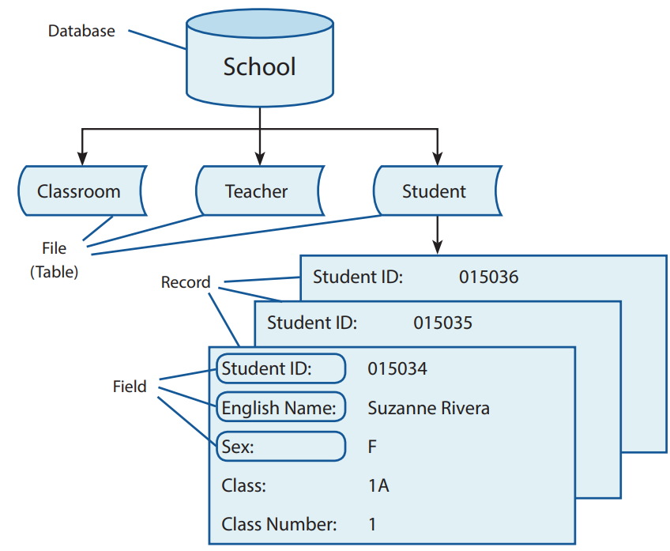
Data Hierarchy
2.1
Data is usually stored in a hierarchical form. In a data hierarchy, every higher level of data is a collection of the items from the lower level.

Slide 4
Data Control
2.2
Data control is the process of managing data. It includes:
Data validation
Data verification

Slide 5
Garbage in, garbage out
A
“Garbage in, garbage out” means that when unreliable or incoherent data is input to a data analysis, the output information will not be useful. Data input errors include:
Error | Description | Example
Data source error | Incorrect data is provided by data source. | Someone provides an email address which does not exist.
Transcription error | data is misread, misheard, or mistyped. | A typesetter mistyped “冶” as “治”.
Transposition error | Incorrect placement of the data. | Someone accidentally reverses two adjacent digits when recording a transaction, making “$15” become “$51”

Slide 6
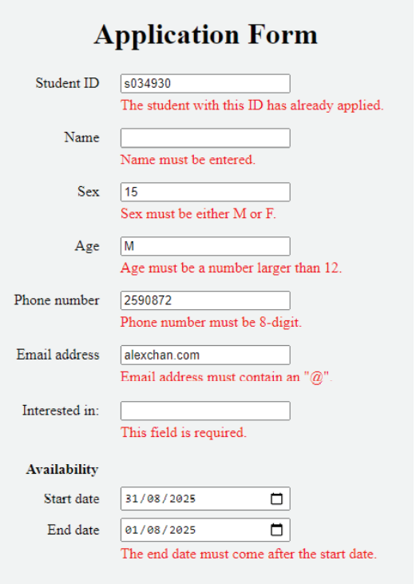
Data validation
B
Data validation ensures that the input data is reasonable and matches certain rules.
It is usually run by systems or programs and widely used in online forms.

Slide 7
Data validation
B
Types of data validation include:
Type | Function | Example
Presence check | It ensures that there must be data in the required fields. | An applicant must provide their name.
Fixed value check | It ensures that the data can only be selected from a list of specific values. | The sex of an applicant must be either “M” or “F”.
Type check | It ensures that the data must be of a certain type. | The age of an applicant must be a number.
Range check | It ensures that the data must be within a certain range. | The age of an applicant must be larger than 12.
Length check | It ensures that the length of the data must match certain criteria. | An applicant must provide an 8-digit phone number.
Format check | It ensures that the data must be in a specific format. | The email address of an applicant must contain an "@" symbol.

Slide 8
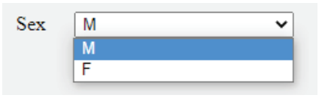
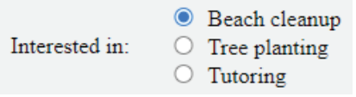
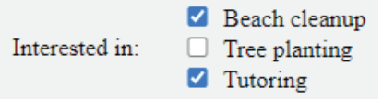
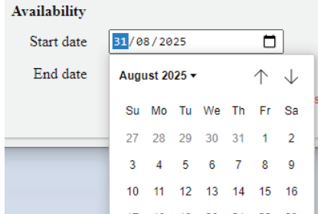
Data validation
B
There are different user interface designs to make data validation easier.
Type | Data validation | Example
Drop-down list | Fixed value check: only one of the specific values can be input.
Radio button | Fixed value check: only one of the specific values can be input.
Checkboxes | Fixed value check: only the specific values can be input. Multiple values can be selected.
Date picker | Type check: only dates can be input. Invalid dates, like “32/08/2025” cannot be picked. Format check: the date must be in a certain format, such as “DD/MM/YYYY”.

Slide 9
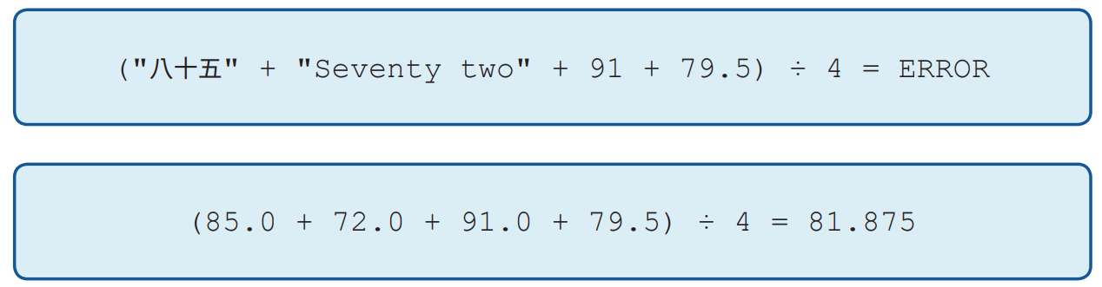
Type check
B
To facilitate data organisation and data analysis, data of the same field should share the same data type.

Slide 10
Type check
B
Commonly used data types for data fields include:
Data type | Description | Example of value |  | Example of usage
Integer | It can be positive or negative. | 74 | -29 | The number of students, the age of a person.
Floating point number/ real number | It can be positive or negative. It can have a decimal point and decimal places. | 2.09 | 1.00 | The score of a student, the height of a person.
String/ text | It consists of characters, which can be English letters, Arabic numerals, Chinese characters, symbols, etc. | “RA^1$” | "日，月" | The name of a student, the address of a person.
Boolean | It can only be TRUE or FALSE. | TRUE | FALSE | Whether a student passes or not, whether a person is alive or not.

Slide 11
Check digit
B
Check digit is a data validation method commonly used for numeric data, such as identity number, book number, credit card number, etc.
The check digit is generated by a specific algorithm and appended to the end of the numeric data. It can consist of more than one digit.

Slide 12
Parity check
B
Data is stored in computers as binary codes. Binary code consists of 0 and 1 only.
A parity bit can be appended to the end of the binary code to ensure that the total number of 1s in the code is even or odd. This is called a parity check.
There are two types of parity checks.
Original binary code | Total number of 1s | The binary code after adding the parity bit
 |  | Even parity check | Odd parity check
0000 000 | 0 | 0000 0000 | 0000 0001
1010 101 | 4 | 1010 1010 | 1010 1011

Slide 13
2.1
To validate a Hong Kong identity card (HKID) number by check digit, we should:
Ensure that it starts with one or two English letters.
Ensure that its weighted sum is divisible by 11.
Ensure that its length is no longer than 9, excluding the parentheses.
(1) only
(2) only
(1) and (3) only
(2) and (3) only

Slide 14
2.1
Analysis
(1) is format check and (3) is length check. Both are reasonable methods to validate an HKID number. However, only (2) is considered as validating by check digit.
Solution
The answer is B.

Slide 15
2.1
During data transmission, four binary codes are received. Given that only one of the codes passes the parity check, which of the codes passes?
1101 1000
1110 1011
0010 0101
0100 1000

Slide 16
2.1
Analysis
The question does not state which parity check it is using. However, it states that only one passes the parity check. Therefore, we need to count the total number of 1s for each code.
Only one of the binary codes has an odd number of 1s.
Solution
The answer is C.
Option | Binary code | Total number of 1s
A | 1101 1000 | 4
B | 1110 1011 | 6
C | 0010 0101 | 3
D | 0100 1000 | 2

Slide 17
2.1
Finish Checkpoint 2.1 on P. 40-41 of the textbook.
B
D
C

Slide 18
Data verification
C
Data verification helps us determine whether the data is accurate and consistent when being transferred between media. Different types of data verification include:
Type | Description
Inputting data twice | It requires an operator to input the same data twice.
Double data entry | It requires two operators to input the same data independently.
Proofreading data | It requires another operator to compare the input data against the original document.

Slide 19
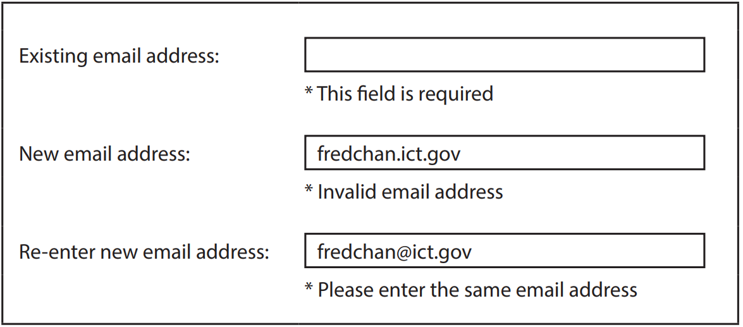
2.2
Fred has an account on an online forum. He wants to change the email address of his account. The forum requires him to fill in the following online form.
Some errors occur when Fred tries to submit the form. Which of the following data control methods are seen in this online form?
Type check
Presence check
Verification by inputting data twice
(1) and (2) only
(1) and (3) only
(2) and (3) only
(1), (2) and (3)

Slide 20
2.2
Analysis
The field “Existing email address” cannot be empty. That means a presence check is applied to make sure this field is filled.
The field “New email address” has an error stating that the email address is invalid. It is because the email address does not contain a “@” symbol and thus its format is wrong. That is a format check, not a type check.
Every user is required to input their new email address twice. That means there is verification by inputting data twice.
Solution
The answer is C.

Slide 21
2.2
An operator entered several 8-bit binary codes from a paper document into an information system. However, one of the 8-bit binary codes was mistyped as shown below: Which of the following data control methods can help the operator find this error?
Double data entry
Parity check
Length check
(1) only
(2) only
(1) and (3) only
(2) and (3) only
Original binary code | Mistyped binary code
0010 0000 | 0100 000

Slide 22

Functions of Database
2.3
Do you know how a huge amount of data (e.g. book data in a library) is organised, stored and retrieved?
The processes are done using database.

Slide 23
Organisation
A
The data in a database is organised according to the database structure.
A good database structure enables a better communication between different tables and reduces data redundancy.
For example:
Field name | Data type | Description
SID | String | The unique student ID of a student. A number cannot have leading zeros, thus it has to be stored as text.
NAME | String | The name of a student.
SEX | String | The sex of a student.
CLASS | String | The class that a student belongs to.
CNO | Integer | The class number of a student.

Slide 24
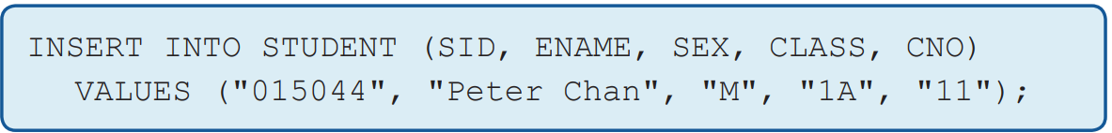
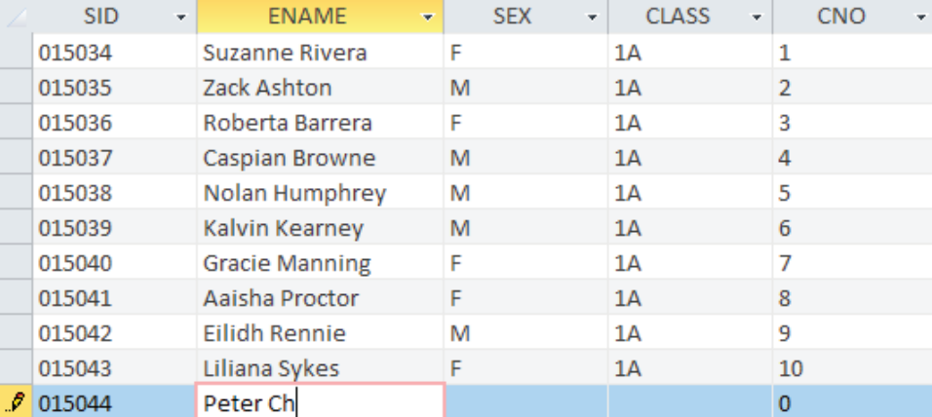
Storage
B
We can insert new records into a database, as well as change or delete existing records by using:
Structured Query Language (SQL)
Graphical User Interface (GUI)

Slide 25

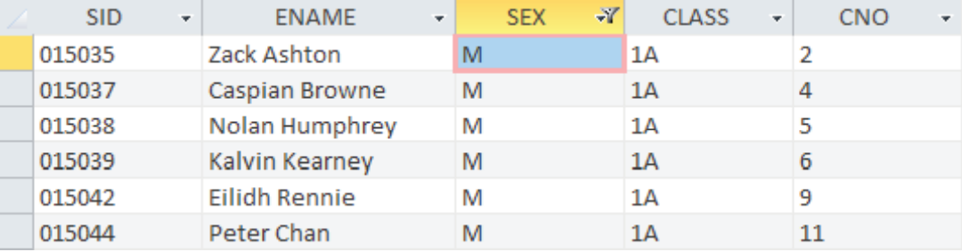
Retrieval
C
We can retrieve specific data from a database by using:
Structured Query Language (SQL)
Graphical User Interface (GUI)

Slide 26
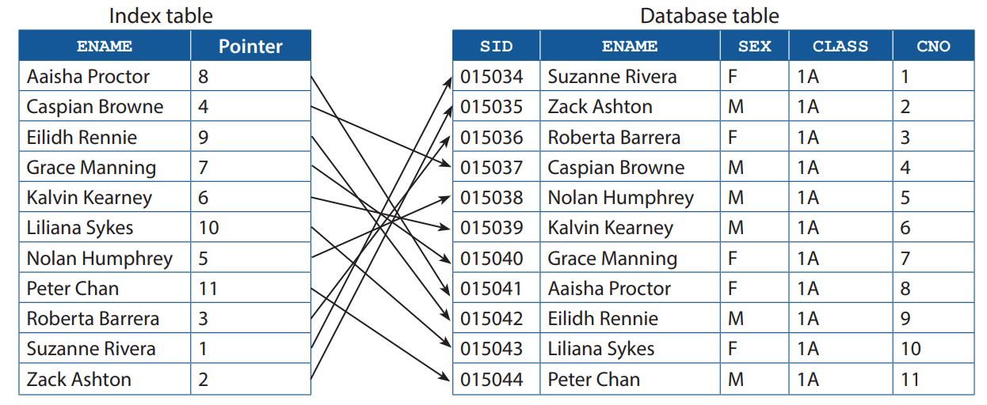
Retrieval
C
We can index frequently accessed fields to speed up the data retrieval process.
Indexing ENAME creates an index table containing the indexed field and a pointer to the related records only.

Slide 27
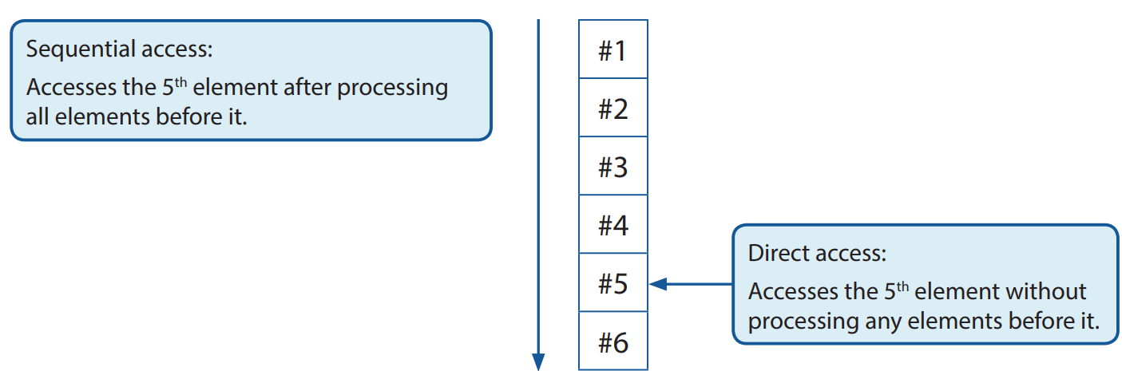
File Access Method
2.4
Data can be stored in different storage devices. The storage devices determine how data is accessed.
There are two common file access methods:

Slide 28
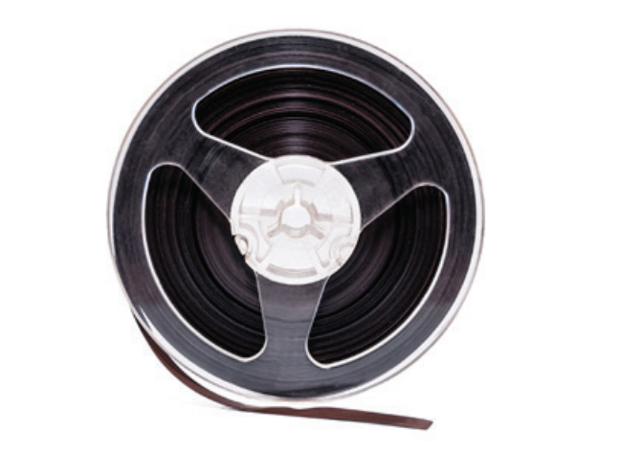
Sequential access
A
For a storage device using sequential access, data is written or accessed sequentially, starting from the beginning. Averagely, it is slower than that of direct access.
Storage devices that use sequential access only include:
Magnetic tape

Slide 29

Direct access
B
For a storage device using direct access, data can be written in any storage position. The access speed of direct access is more stable and generally faster than that of sequential access.
Storage devices that use direct access include:
Hard disk
USB flash drive

Slide 30
2.3
A teacher wants to store the information of Class 1A students in a database table. Here is the table structure:
Which of the following types of validation checks is/are suitable for the field CNO?
Uniqueness check
Type check
Presence check
(2) only
(1) and (2) only
(2) and (3) only
(1), (2) and (3)
Field | Data type | Description | Example
CNO | Number | Class number | 1
NAME | Text | student number | 陳大文
GENDER | Text | Gender | M

Slide 31
2.3
Analysis
For (1), since all information in the table comes from students of the same class, Class 1A, the class number of a student should be unique.
For (2), given that the data type of CNO is a number, a type check is needed.
For (3), every student must have a class number.
Solution
The answer is D.

Slide 32
2.3
Finish Checkpoint 2.3 on P. 51 of the textbook.
B
C

